Slide 1
Rain Simulation - GA Final Project
By: Enoch Huang

Slide 2
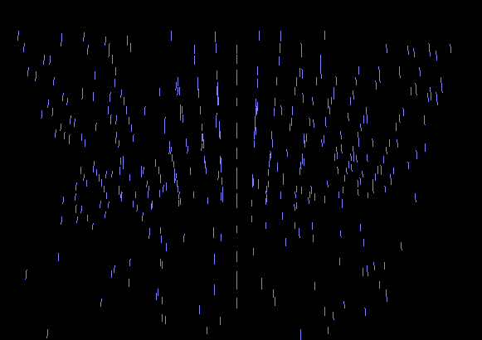
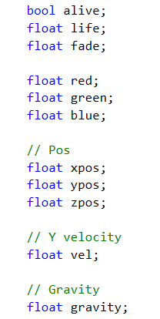
Summary
For my final project, I implemented a simple rain simulation using particle systems.
The user has the option to toggle between rain and snow particles, modify the speed of the particles, as well as the density of the particles.
When the particles collide with the ground, they either despawn or bounce off the ground depending on user control.
Both particles leave color accumulation on the ground.

Slide 3
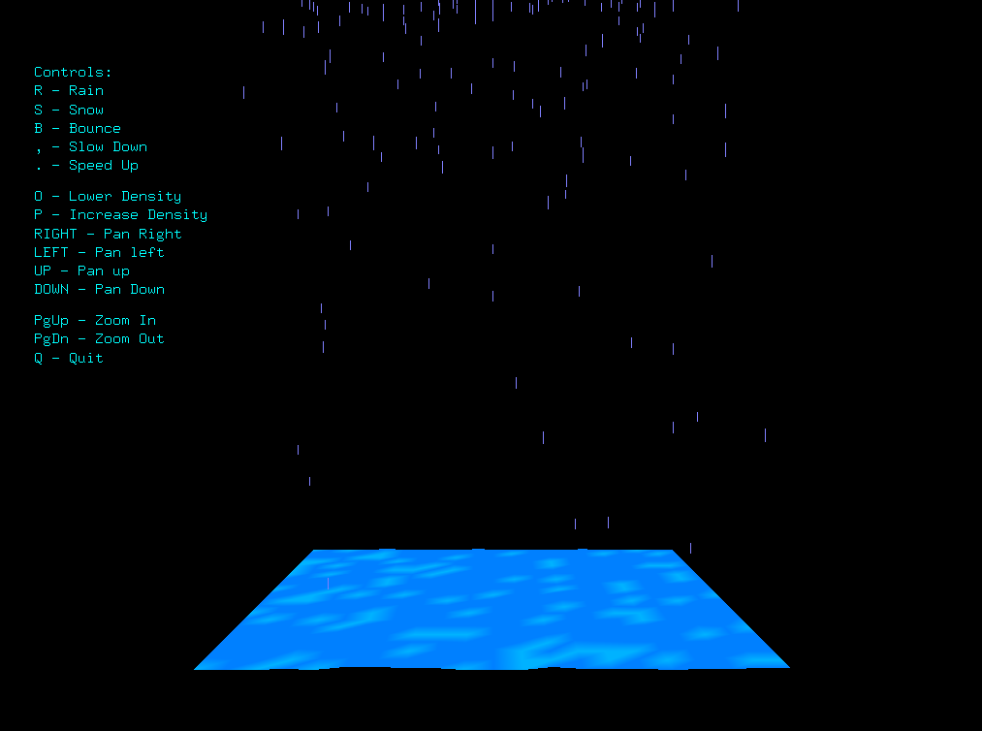
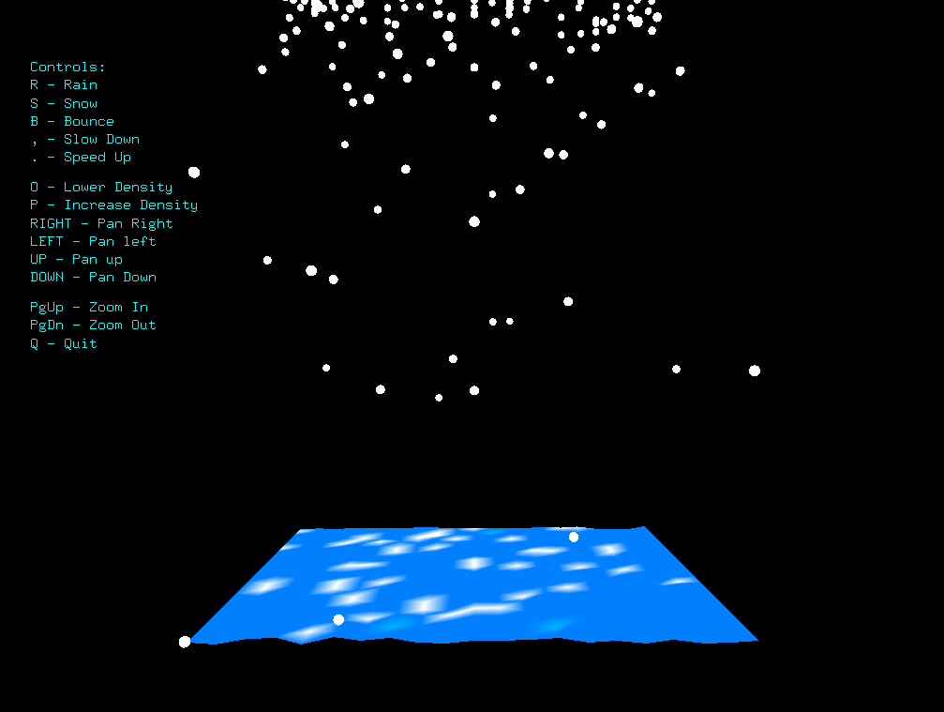

Slide 4
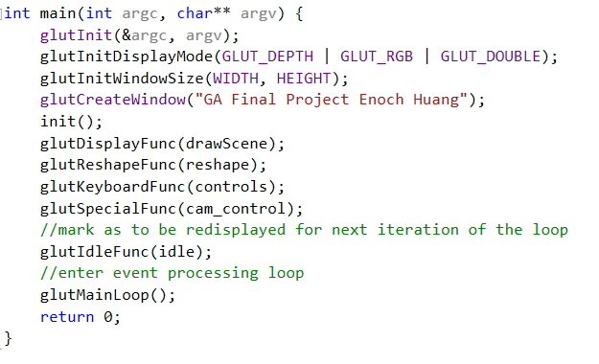
Technical Challenges
Determining what libraries to use
Figuring out which libraries were needed in order to accomplish the features I wanted
Since we used OpenGL for graphics in class, I did some further research, and found that I could use Freeglut, an alternative to the OpenGL Utility Toolkit (GLUT)
Very simple to handle input events, made looping very easy

Slide 5
Technical Challenges
I also had some difficulty figuring out how to draw the ground plane, as I was not familiar with the GL functions.
Researched online and our past homeworks how to draw a plane.
Learned about functions like glColor3fv, glVertex3f, and glMatrixMode.

Slide 6
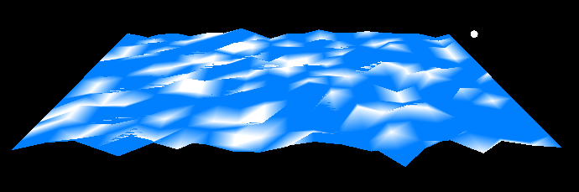
Technical difficulties
After I had a basic particle system of rain drops that would fall to the ground, I originally wanted to have a more realistic representation of accumulation of the droplets
However, due to time constraints, I decided it would be easier to simply change the color of the ground at the point at which the droplets hit the ground.
If snow hits the ground, that point on the ground will get raised a tiny bit, opposite for rain.
To kind of simulate a splash, I made it possible to toggle on a bounce effect, which would make the droplets bounce off the ground.
Works, but not perfect, also difficult to see

Slide 7
Future work and improvements
To have a splash effect, maybe I can just create a particle system at the point that a droplet hits the ground that will spawn tiny drops into the air.
I would also like to continue adding more user controls to change little details of the simulation
Some functions might include being able to change the size of the ground, change the area of rain/snow, and add a sun effect that can dry out the rain and snow on the ground
I would also like to look into how to simulate water accumulation on the ground, not just changing the color of the ground
Maybe I could accomplish this by giving the ground a value (something like waterLevel), and every time a droplet hits the ground it will increase that value, and once the value reaches a certain point I can draw a transparent blue rectangle on top of the ground to simulate water accumulation

